Slide 1
Energy Sustainable Florida Communities Project
FSU Institute for Energy Systems Economics & Sustainability,
Energy & Governance Center
Richard C. Feiock Ph.D.
Augustus B. Turnbull Professor of Public Administration
Florida State University
rfeiock@fsu.edu

Slide 2
Overview
Adoption of Climate Protection Agreements by Florida Local Governments
Explanations
Analysis and Conclusion
Survey of Florida Local Governments
Overview of Actions and Activities
Response to HB697
Ongoing Projects

Slide 3
Collective Action Problems and Adoption of Climate Protection
Many Florida communities have taken E/CP actions on a voluntary basis.
free-riding is much less of a barrier to policy adoptions than predicted by theory.
Why?
Local officials are able to overcome collective action problems when the benefits, including political benefits, are sufficient to overcome the barriers to adopting policy initiatives.

Slide 4
Transaction Costs Barriers to E/CP
Barriers to E/CP innovation are reduced by:
Interactions within local policy networks
Production of localized benefits
Complimentary effects for ongoing environmental, development or growth management efforts
Generation of selective benefits to elected and appointed local governments officials

Slide 5
Demands and Incentives
Community Demand
Population
Education/Preference for Public Goods
Environmental preferences
Climate change risk
Institutional Incentives
Form of government and career incentives
Council representation “at large”

Slide 6
Localized Policy Benefits
Energy Conservation
cost savings
Emission reductions
pollution reduction and public health benefits
Economic Development
New energy economy
Receptiveness to “green economic development”
Growth Management and Smart Growth
traffic congestion, high density urban design.

Slide 7
Data
The dependent variable is based on data reported by USCM and phone calls to each adopting municipality in Florida to determine is a resolution was passed and when.
Demographic variables are from Census sources.
Policy expenditures were taken from city annual financial reports.
Government variables are from the League of Cities.
Environmental support derived from tag revenues collected by the Florida Department of Revenue.

Slide 8
Methods
The dependent variable is a binary indicator for policy adoption over time, therefore a panel logit is used to analyze the data.
The model employed GEE estimation because we are interested in the population average over all cities.
An AR(1) covariance structure was used.

Slide 9
Results
 | Estimate | Std Error | Z | Pr > |Z|
Environmental tags | 1.4579 | 0.9335 | 1.57 | 0.1004
% White | -0.0123 | 0.0121 | -1.02 | 0.3078
% College degree | 0.0407 | 0.0155 | 2.62 | 0.0087
City Manager | 0.0446 | 0.5607 | 0.08 | 0.9367
% District rep | -1.2118 | 0.5821 | -2.08 | 0.0373
Population (log) | 0.9747 | 0.2156 | 4.52 | <.0001
Per capita expenditures | 0 | 0 | 1.13 | 0.26
Utilities (lag) | -0.4222 | 0.5953 | -0.71 | 0.4781
Planning exp (lag) | 0 | 0.0001 | -0.01 | 0.9939
Econ develop exp (lag) | 0.0001 | 0.0001 | 1.82 | 0.0691
Costal mileage | 0.0025 | 0.0031 | 0.79 | 0.4296
Air quality | -0.0088 | 0.0222 | -0.4 | 0.6911

Slide 10
Results Summary
Larger, higher spending, and well educated cities are more likely to adopt agreements.
Some support for institutional influences from district representation.
Economic development policy positively related to adoption of climate protection agreements.
Need to go beyond symbolic action
SURVEY of ENERGY AND CLIMATE PROTECTION ACTIONS

Slide 11
SURVEY PROJECT:
Energy Sustainable Florida Communities
Richard Feiock and Ivonne Audirac, FSU
Some VERY PRELIMINARY Results
The Institute for Energy Systems, Economics and Sustainability (IESES) at Florida State University is investigating Florida local government actions related to energy efficiency and climate change to better understand and assess local efforts and to assist local governments in Florida. This project is supported by the FSU Center for Florida Local Government Excellence. Your participation is critical to the success of these efforts. This survey will take approximately 20-30 minutes to complete. We anticipate that the results will also benefit local governments and we will share these results with all participants.
Your answers to survey questions will remain confidential to the full extent allowed by law. The results of this research study will be published, but individual respondent will not be identifiable in any reports. If you have any questions concerning this research study, please contact Dr. Richard Feiock by email at rfeiock@fsu.edu or phone at (850)644-3525. Thank you.
Please return this questionnaire to:
Richard C. Feiock
Askew School of Public Administration and Policy
Florida State University
Tallahassee FL 32303-2250

Slide 12
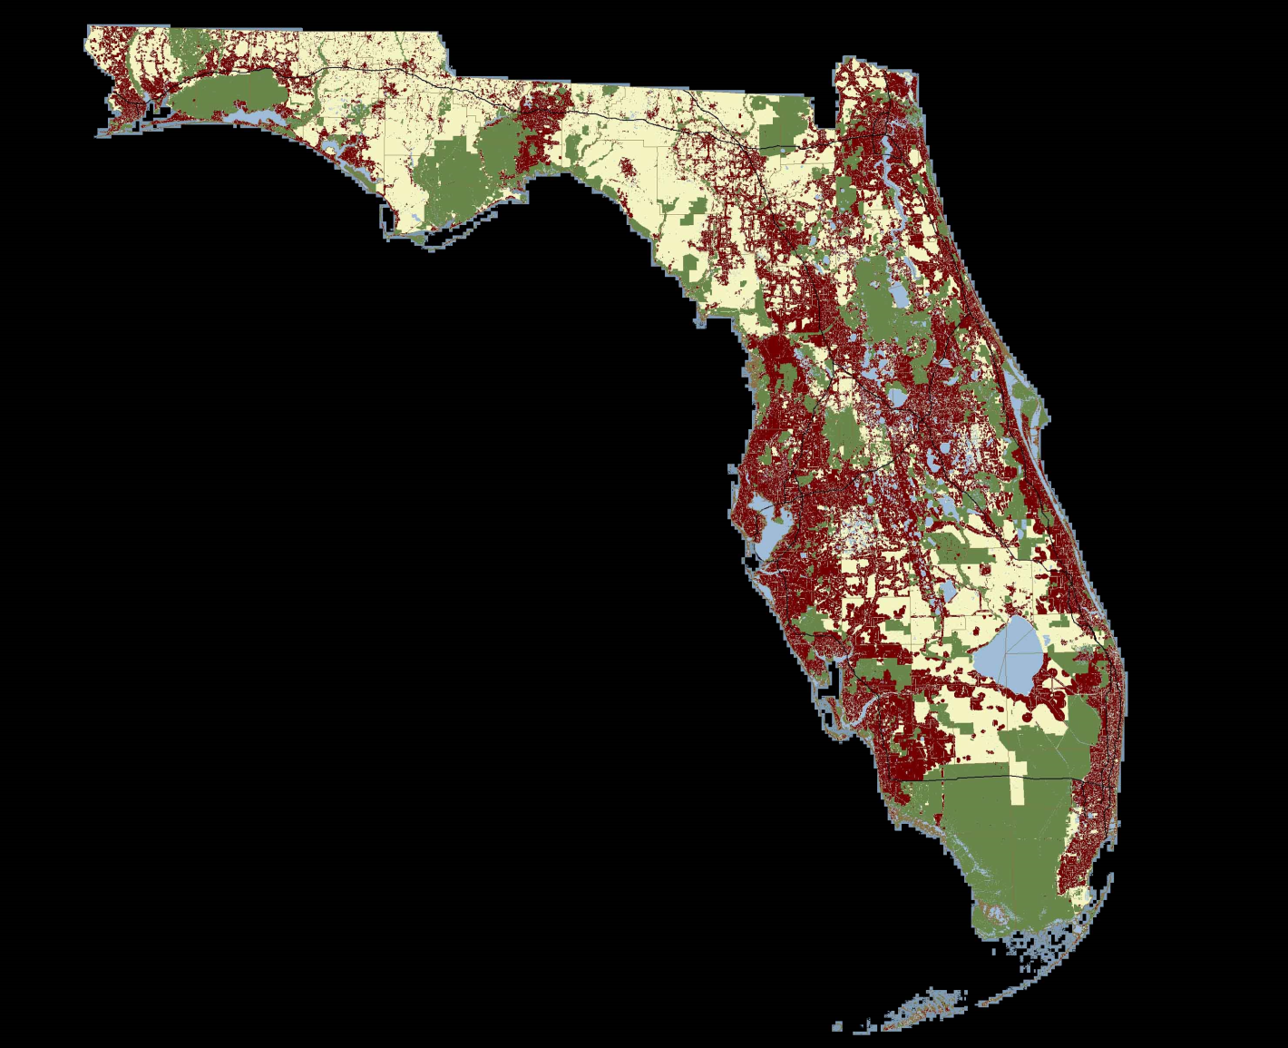
Survey of Florida Local Governments
Identifying the elements of energy sustainability:
Energy & Climate Policy
Comprehensive Plans & State and Federal Policy
Zoning Regulations Subdivision Regulations and Permitting
Land Use and Open Space
Housing and Green Building
Transportation
Economic Development
Energy Cost Reduction by Government
Organization and Intergovernmental Relations
Investing in Energy & Climate Change Competencies

Slide 13
Importance of Energy/Climate Issues

Slide 14
Departmental Responsibility

Slide 15
Obstacles to Sustainability

Slide 16
Importance of Green Business

Slide 17
Addressed in Comp Plan Elements Prior to HB697

Slide 18
Approach to HB697

Slide 19
We Need Your Help
Please complete this questionnaire
The Institute for Energy Systems, Economics and Sustainability (IESES) at Florida State University is investigating Florida local government actions related to energy efficiency and climate change to better understand and assess local efforts and to assist local governments in Florida. This project is supported by the FSU Center for Florida Local Government Excellence. Your participation is critical to the success of these efforts. This survey will take approximately 20-30 minutes to complete. We anticipate that the results will also benefit local governments and we will share these results with all participants.
Your answers to survey questions will remain confidential to the full extent allowed by law. The results of this research study will be published, but individual respondent will not be identifiable in any reports. If you have any questions concerning this research study, please contact Dr. Richard Feiock by email at rfeiock@fsu.edu or phone at (850)644-3525. Thank you.
Please return this questionnaire to:
Richard C. Feiock
Askew School of Public Administration and Policy
Florida State University
Tallahassee FL 32303-2250

Slide 20
Our Research Agenda
EECBG Projects and Policy Innovation
Networks and Innovation
ICLEI membership adoptions 1990 to 2009
Diffusion of Innovation
E/CP and Economic Development

Slide 21
Thank You
Rick Feiock
Sustainable Energy Governance Center
http://seg.fsu.edu

